Slide 1
PROJECT 3
SQL FOR DATA ANALYSIS

Slide 2
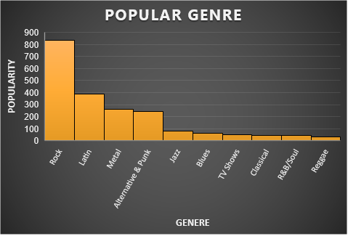
POPULAR GENRE
<visualization>
As it is clear in visualization ROCK is the leading genre and most popular among customers.
If we are looking to do some promotions ROCK Genre is the best and most stable to do promotions.

Slide 3
TOP 10 ARTIST
<visualization>
The leading singer among all singers is Iron Maiden. He is leading with 213 songs.
To make concert successful Iron Maiden is the best as he is the most popular singer among customers

Slide 4
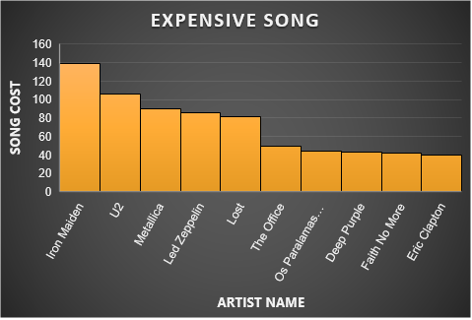
WHICH ARTIST EARNED THE MOST?
<visualization>
The most expensive singer is Iron Maiden , as may be he is from popular genre.

Slide 5
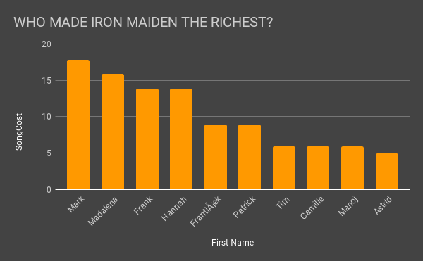
WHO MADE IRON MAIDEN THE RICHEST?
<visualization>
From previous slide we can see Iron Maiden were most popular among Rock genre so in this slide we find out which fan spend most on this band and how much.
Mark Taylor spend the most $17.82 on song ‘The Assassin’ by Iron Maiden.

